Slide 1
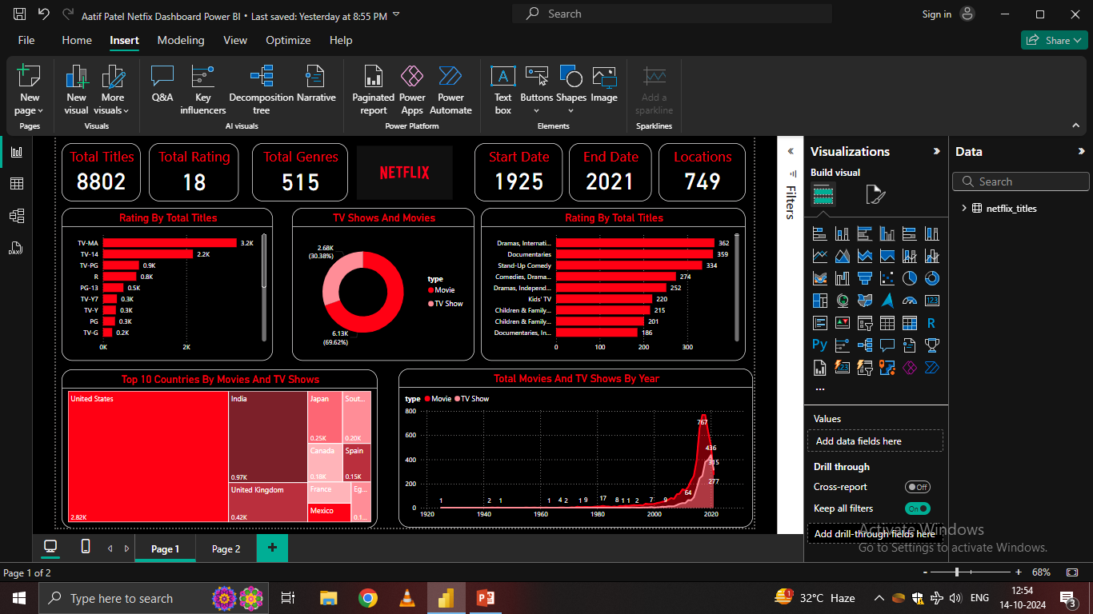

Slide 2
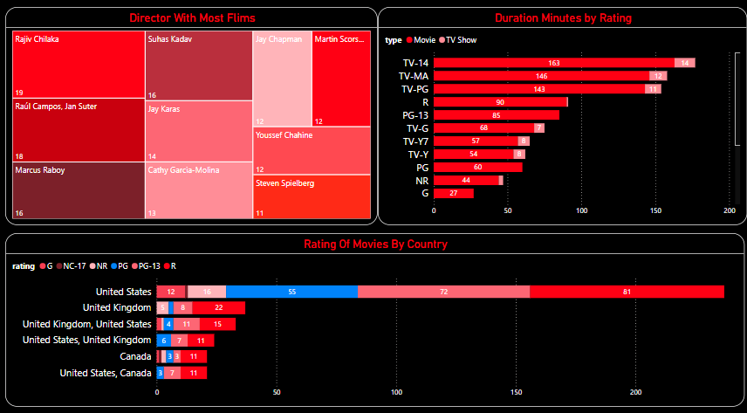

Slide 3
Questions
How many total titles are available on Netflix?
What is the distribution of Netflix content by movie versus TV shows?
Which genres have the most content on Netflix?
How have the number of movies and TV shows grown over time on Netflix, and when did the biggest spike occur?
Which countries produce the most Netflix content, and how do they rank?
What are the top 10 countries by Netflix movies and TV shows?
What is the earliest and latest start date for Netflix content in the dataset?
How does the genre diversity compare across movies and TV shows on Netflix?

Slide 4
Conclusion
Massive Content Catalog: With over 8,800 titles, Netflix offers a vast library of movies and TV shows spanning across 18 different ratings and 515 genres.
Dominance of Movies: Movies dominate Netflix’s catalog, accounting for nearly 70% of total content, with TV shows comprising around 30%. This suggests that Netflix focuses more on single-standing films than series.
Content Growth Over Time: A significant surge in Netflix’s content occurred around the 2010s, particularly between 2020 and 2021, reflecting the platform's aggressive expansion and possibly responding to increased streaming demand during the global pandemic.
Popular Ratings and Genres: The most common content rating is TV-MA (suitable for mature audiences), with TV-14 closely following, indicating a substantial portion of content aimed at adult viewers. Popular genres include dramas, international documentaries, and stand-up comedy, reflecting a growing interest in diverse, global content.
Geographic Diversity: Netflix’s content comes from a variety of countries, with the United States leading by a wide margin. Other significant contributors include India, the United Kingdom, and Japan, showcasing Netflix’s global reach and its role as a platform for both local and international content creators.

